Slide 1
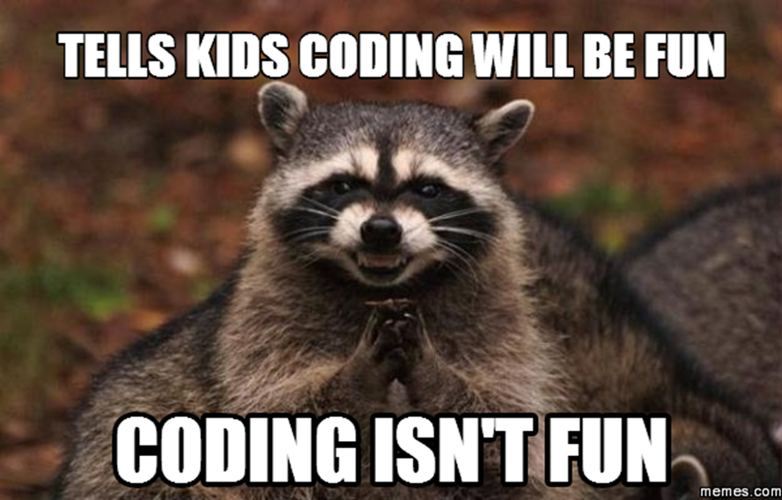
Build A Web Application without Coding
Kenny Robinson

Slide 2
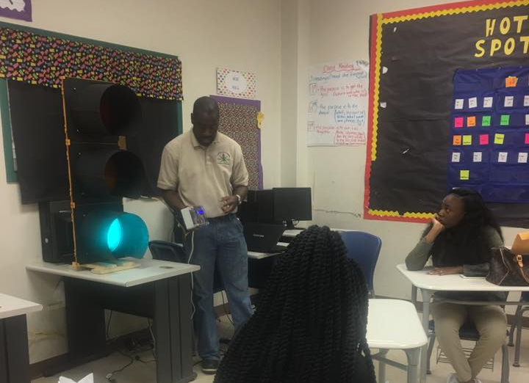
Kenny Robinson
Bachelor’s in Business from University of Alabama
Day Job: Production Support, IT Consultant
https://www.linkedin.com/in/krobinsontech/
https://github.com/bitsecondal
When not working the day job…

Slide 3

What is Drupal?
Content management system
Similar to WordPress or Joomla
Open source
Created by Dries Buytaert
Additional functionality can be added using “modules”
WordPress translation “plug-ins”
More technically advanced
Current versions are 7 and 8
Command line interface available
Drush
http://www.drupal.org

Slide 4
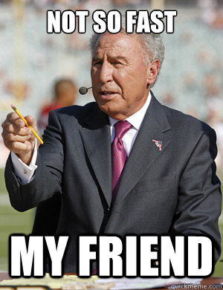
I’ve Never Used A Drupal Website!!

Slide 5
I’ve Never Used A Drupal Website!!
White House
whitehouse.gov
FEMA
fema.gov
Case Study: https://www.acquia.com/resources/case-study/fema-rebuilt-deliver-powerful-user-experience
The Weather Channel
weather.com
Case Study: https://www.drupal.org/node/2374175

Slide 6
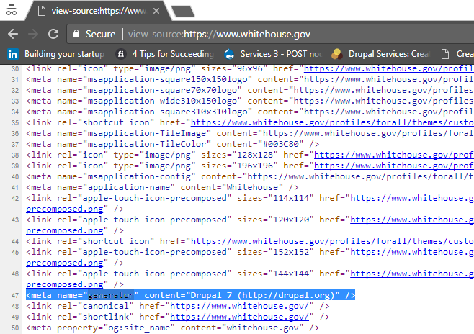
Sources Cited: whitehouse.gov

Slide 7
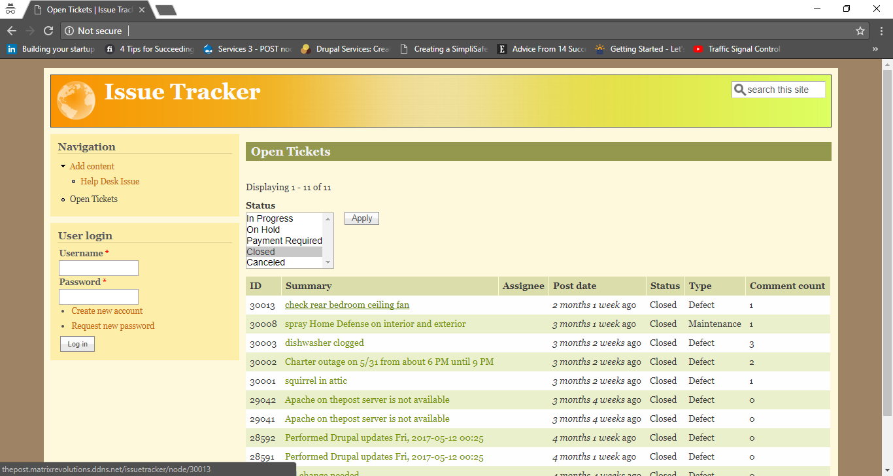
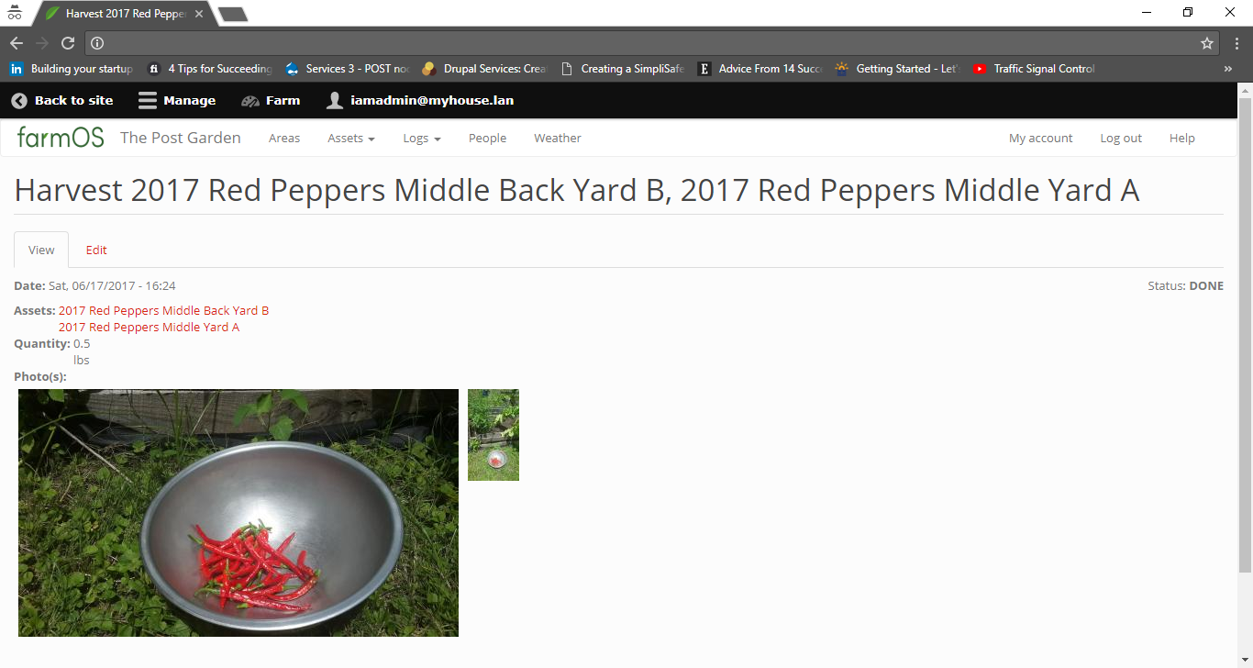
Personal Uses
farmOS
Issue tracker
automation

Slide 8
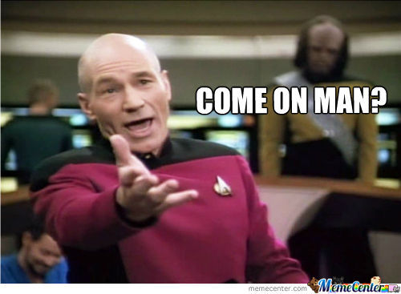
Demonstration: The Knowns
Not great at coding / do not know how to code
1 business day (8 hours) to complete entire release cycle
Develop, test, and release
No project plans
Web-based application
mobile API
mobile browser friendly
Login ability for client to do self updates

Slide 9
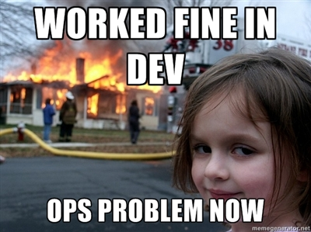
Demonstration: The Build
https://github.com/bitsecondal/fastwebapp

Slide 10
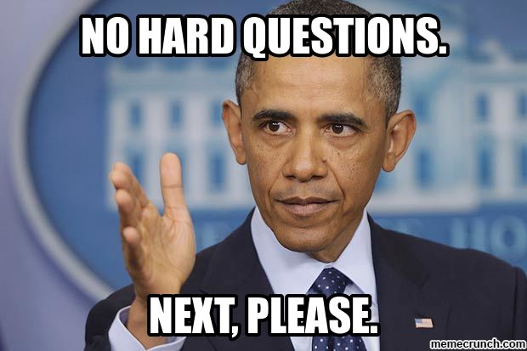
Questions?

